Slide 1
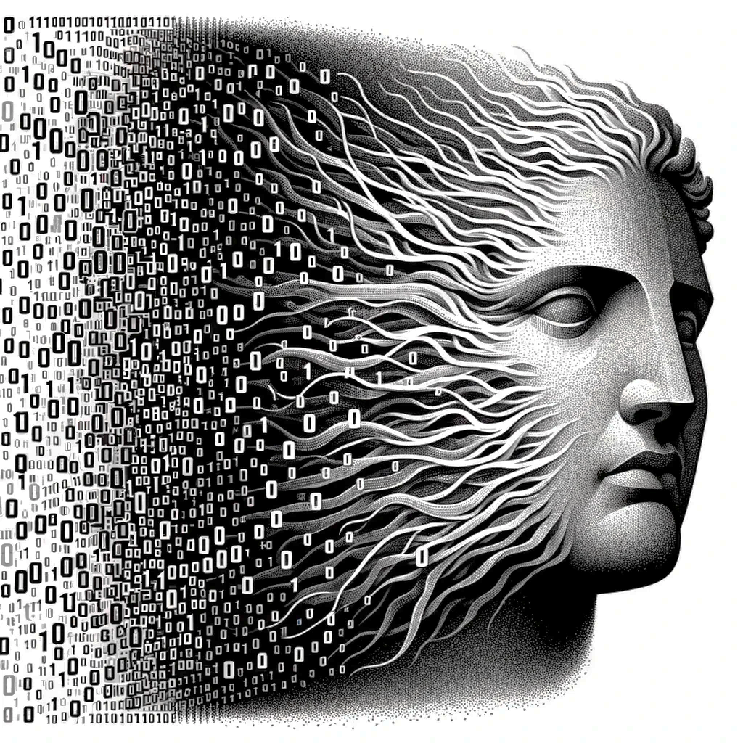





2024
Atalanta:
A Bit is Worth a “Thousand” Tensor Values
Alberto Delmas Lascorz, Mostafa Mahmoud, Ali Hadi Zadeh, Miloš Nikolić,
Kareem Ibrahim, Christina Giannoula, Ameer Abdelhadi,
and Andreas Moshovos^{1,2}
Notes:
Hi everyone, I am Christina from the University of Toronto and I will be presenting our work Atalanta
Just a quick note on the presentation today: Our co-author Kareem was planning to give this presentation today.
However, due to last minute emergency, he will not be able to present, and please forgive me if I am not able to provide a high quality talk.
This project is a collective effort, and I'm here to represent our group, especially Alberto, who is the lead author of this work.

Slide 2
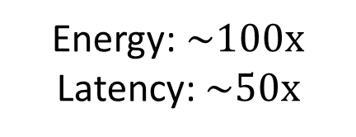
On-Chip
Off-Chip
Compute Cores
Memory
Compute Cores
Energy: $\sim 100x$
Latency: $\sim 50x$
On-Chip
Memory
Fixed-Point Data
Compressed Data
Notes:
Our work, targets the significant energy and latency costs associated with communication in typical systems. Going offchip in such systems can consume
up to 100 times more energy and can be 50 times slower compared to on-chip memory usage.
'Atlanta' operates just before the off-chip memory controller, compressing
fixed-point data for off-chip storage and transfer, which reduces the associated costs.

Slide 3

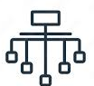

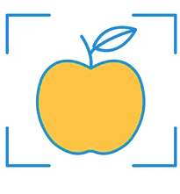
Fixed-Point Data
Compressed Data
Inference
&
Training
Transformers
Classification
Recommendation
Detection
Notes:
"'Atlanta' is optimized for machine learning workloads,
functioning during both inference and training.
It was successfully evaluated on a diverse set of model classes including transformers, image classification, object detection, and recommendation systems.

Slide 4
Lossless
Original Data
Compressor
Comp.
Data
Decompressor
Decoded Data
Notes:
Atalanta is lossless which simply means,
the data you put in is exactly what you get out after compression/decompression process. This guarantees that the performance of your tasks remains untouched, like accuracy in classification tasks.

Slide 5

Lossless
Transparent
Compute Cores
Compute Cores
Atalanta
On-Chip
Memory
Notes:
'Atlanta' is its Programmer transparent.
a low-level driver manages data transfers discreetly.

Slide 6
Lossless
Transparent
High Compression
W
A
W
A
W
A
W
A
W
A
W
A
W
A
W
A
W
A
W
A
W
A
W
A
W
A
48%
W
W
60%
A
W
A
Notes:
Atalanta provides high compression efficiency.
On average, It reduces the size of
weights to 60% and activations to 48% of their original volume. which translates directly into cost savings and improved efficiency.

Slide 7

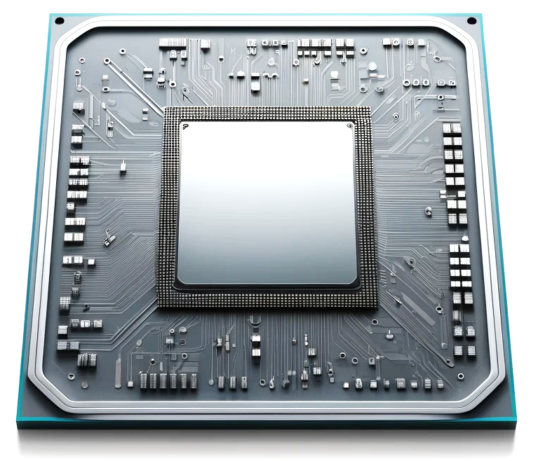

Lossless
Transparent
High Compression
Low Cost
Notes:
Atlanta’ comes with low cost.
It incorporates just a tiny additional hardware unit, which hardly affects overall energy consumption and resources.

Slide 8
Roadmap
0
1
2
3
4
5
Motivation
Key Idea
Atalanta’s
Software
Atalanta’s
Hardware
Results
Conclusion
Notes:
After going over Atalanta’s main features, we will discuss its key idea, what does it do in both software and hardware then some key results.

Slide 9

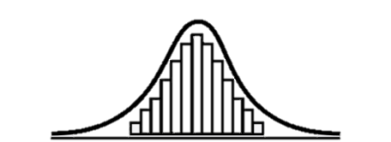
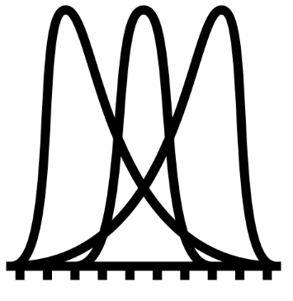
Fixed-Point Data
Compressed Data
Weights
Profile
Activations
Notes:
In this problem, We're working with fixed-point data, and our goal is to find an effective way to compress this data that does not only offer high compression but also comes at a low cost. We handle two types of data:
weights, where the distribution is already known, and
activations, for which we can perform profiling by running multiple examples to obtain a representative distribution.

Slide 10

Arithmetic Coding?
How to effeciently compress?
Notes:
And Once we know these distributions,
the next step is to find the most efficient way to compress our fixed-point data. Historically, we've seen success with well-known algorithms
like arithmetic coding, which has been a reliable method since 1980s. It’s known to be efficient especially when you know the data's distribution. -- Before we move on, let's quickly revisit arithmetic coding

Slide 11
Arithmetic Coding
INT8
Tensor
12, 0, 23, 45, 67, 127, 18, 22, 88, 103, 234, 22, 1, 0, 2, 3, 5, 8, 19, 9, 0, 9, 8, 20, 28, 220, 20, 20, 1, 0, 19, 9, 0, 9, 8, 20, 28, 220, 20, 20, 244, 223, 2, 1, 1, 0, 1, 0, 12, 0, 23, 45, 67, 127, 18, 22, ……………………………………
2, 3, 5, 8, 28, 220, 20, 20, 244, 223, 2, 1, 1, 0, 1, 0, 234, 22, 1, 0, 2, 3, 19, 9, 0, 67, 127, 18, 22, 88, 103, 5, 8, 9, 8, 20
0.1023846489202837462829838393….333292
=
0.110101010101010101011110101…111001₍₂₎
Notes:
Arithmetic coding takes an entire sequence of data samples, in this case values of an int8 data tensor, and it transforms them into a single real number. The number of bits required to represent the sequence depends on the sequence length or number of elements in the tensor and the frequency of each element

Slide 12

Arithmetic Coding – INT2 Example
1
S3 Frequency
= 0.25
S2 Frequency
= 0.25
0.11001010101…101₍₂₎
S1 Frequency
= 0.5
NOTHING IS
PERFECT
S0 Frequency
= 0.25
0
Notes:
And For simplicity, let’s consider an INT2 tensor as an example datatype
INT2 has 4 possible values or symbols S0 to S3. and AC begins by identifying the probability of each symbol in our sequence.
Then Based on these probabilities, each symbol is assigned a corresponding range on the number line between 0 and 1.
the encoding process is then done sequentially by choosing a symbol and dividing its range into new subranges
Each symbol in the sequence progressively narrows down the range
And This process continues for all tensor values until we reach the final range that represents the entire sequence of symbols.
Again, Arithmetic coding is near optimal in its compression ability
However, it comes with challenges if we want to implement it in hardware

Slide 13
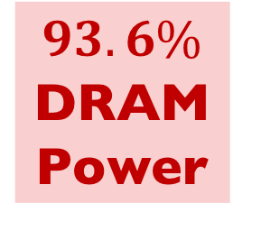
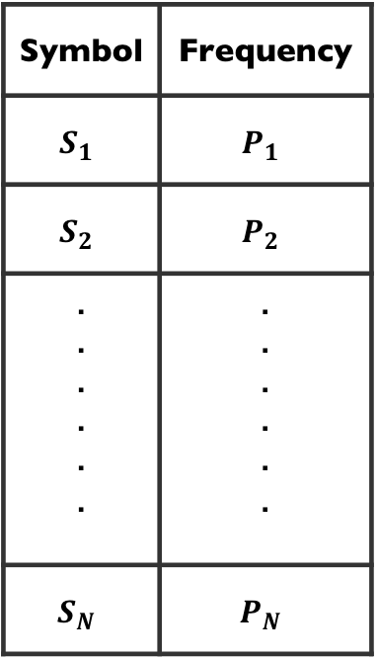
Arithmetic Coding – Probability Table
0
Symbol | Frequency
$$S_{1}$$ | $$P_{1}$$
$$S_{2}$$ | $$P_{2}$$
. . . . . . | . . . . . .
$$S_{N}$$ | $$P_{N}$$
INT8
256 Entries
$$93.6\%$$
DRAM Power
1
Notes:
Starting with the first challenge:
To operate, arithmetic coding constantly needs access to probability tables that
Track each symbol and its frequency
For an INT8 data type, the table has 256 entries, one for every possible value and maintaining and looking-up this table is not only space-consuming but also power-intensive.
and In fact, in a typical setup, this can consume as much as 93% of the DRAM power.

Slide 14


Arithmetic Coding – Precision
1
Expandable Precision
Costly
Operations
0.110010….…101₍₂₎
0
Notes:
Moving on to the second challenge.
As we encode symbols, the precision needed increases because our range keeps getting smaller.
And As the algorithm requires costly arithmetic operations, such as wide multiplications and divisions,
These consume more energy, increase latency, and require larger circuits, which makes it unfavorable in hardware.

Slide 15
Arithmetic Coding – Bandwidth
Input Data
Arithmetic
Coding
Output
1 bit/cycle
Notes:
Lastly, arithmetic coding is inherently sequential, which may not align well with the parallel processing demands of our workloads This nature limits its encoding and decoding rates,
And it may generate only 1 bit per cycle in its base implementation

Slide 16

Atalanta – Key Idea
VALUE | = | BASE | + | OFFSET
int8 |  | 3 bits |  | 5 bits
01010111 | = | 01000000 | + | 10111
Store
Apply AC
256 Entries
8 Entries
Notes:
Atalanta offers near-AC efficiency while being practical through some key techniques
First, it partitions the value space into subranges of values sharing a common base with each value represented as Base + offset
For an int8 datatype this can be 3 bits for base and 5 bits for offsets
Atalanta then applies AC only on the base part while storing offsets directly
This lowers the number of entries in the probability table from 256 to 8

Slide 17


Atalanta – Key Idea
VALUE | = | BASE | + | OFFSET
8 bits |  | 3 bits |  | 5 bits
$$≈$$
Notes:
Why does this work? Basically,
if we have a certain value distribution like this which is the case for weight tensors, AC can make use of different frequencies and efficiently compress them
and if we divided it into 8 subranges for a 3-bit base.
The distribution of bases will closely mirror the original value distribution.
However, for offsets, they are left with at least 5 bits per value. So, how do we address this? Our goal is to ensure that Arithmetic Coding of bases covers most of the values and I will show how to achieve this.

Slide 18
Software
Profiler
Hardware Runtime
[Encoder/Decoder]
Notes:
But first, At a high-level, Atalanta has two key components: a software profiler and a hardware module. The profiler pre-analyzes data prior to runtime, supplying the hardware module with statistics and values required for runtime

Slide 19
Atalanta – Software Profiler
W
A
Software
Profiler
Search
Frequent
= Fewer offset bits
Infrequent
= More offset bits
Notes:
So, what does the profiler do? It takes a weight or activation tensor and generates
a histogram of values. -- And then Atalanta runs a simple algorithm to search for the subranges iteratively. and it basically says: If I'm going to encode numbers as base plus offset, with offsets stored directly.
Find me subranges that lower the total footprint with subranges that are not necessarily equal -- And the idea is that Values that are very frequent
like the ones here, they're going to be assigned very short ranges, so they have very few offset bits as they contribute more significantly to the overall data footprint.
And The opposite happens for infrequent values like this range

Slide 20
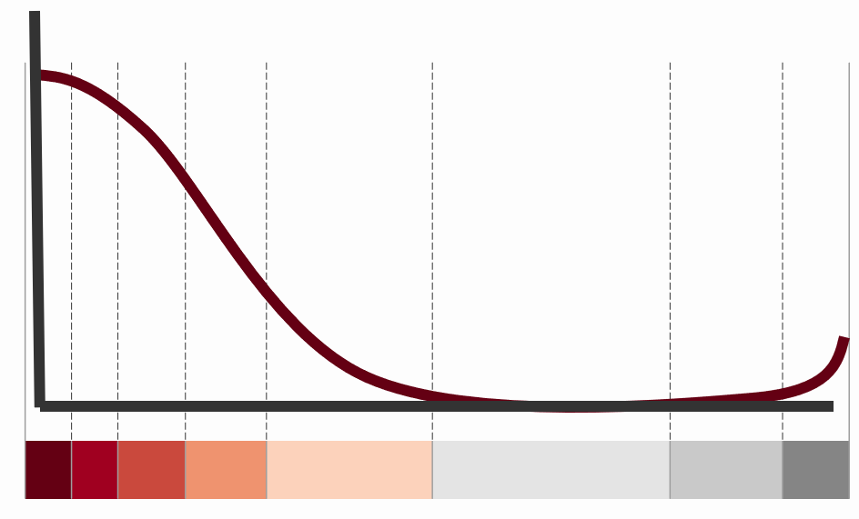
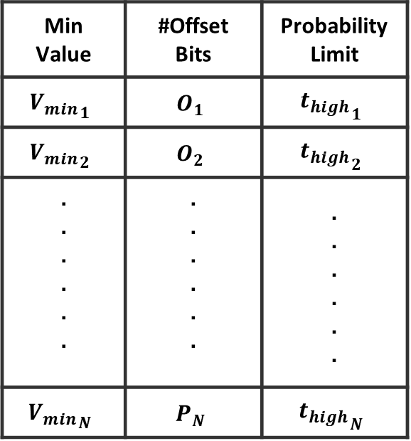
Atalanta in Software
8b
3b
10b
Min Value | #Offset Bits | Probability Limit
$${V_{min}}_{1}$$ | $$O_{1}$$ | $${t_{high}}_{1}$$
$${V_{min}}_{2}$$ | $$O_{2}$$ | $${t_{high}}_{2}$$
. . . . . . | . . . . . . | . . . . . .
$${V_{min}}_{N}$$ | $$P_{N}$$ | $${t_{high}}_{N}$$
8/16
Entries
Notes:
After figuring out the subranges
A probability table is created And for each subrange, the minimum value is stored in 8-bits, the number of offset bits is stored in 3-bits, and a probability limit that indicates the subrange frequency is stored in 10 bits. In our experiments, 3 or 4 bits for index were enough so this table
will have 8 or 16 entries only in most cases.

Slide 21
Atalanta Encoder in Hardware
Input Symbol
Output Code
Combinational
Logic
Storage
< 50 Bytes
Notes:
then in Hardware, this probability table along with other storage elements requires storage of less than 50 bytes per instance and the rest of the unit is combinational logic. For more details on our hardware, please read our paper.

Slide 22






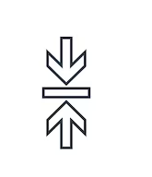


Atalanta During Inference Evaluation
EFFICIENTNET v2
Bit Plane Compression
(BPC)
Notes:
Going into evaluation, we compared Atalanta to 2 different classes of compression algorithms
Widely used powerful algorithms like LZMA. This class of algorithms is powerful but very expensive to implement in hardware
The other class is hardware-friendly (GPU) compression methods like bit plane compression used in our comparisons
We did this for multiple models and modalities like transformer llama2 and GPT2 models and recent efficientnet and yolo vision models.

Slide 23
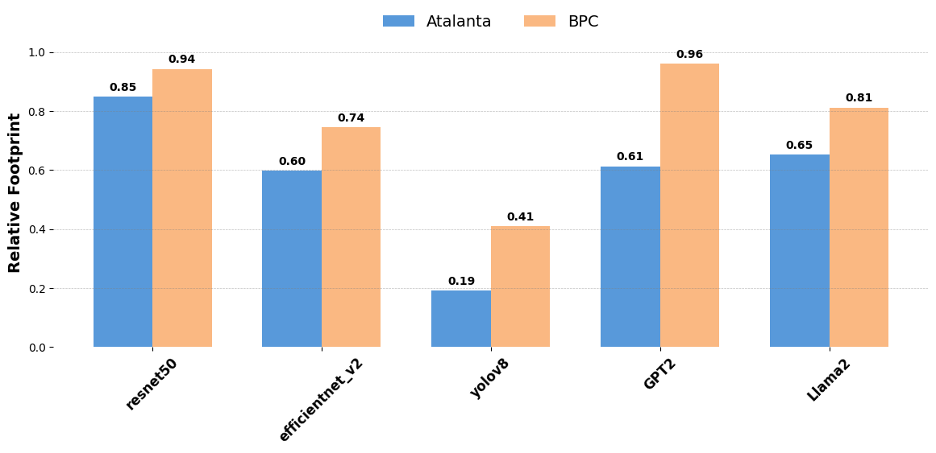



Compression Performance: Weights
$$−9\%$$
$$−35\%$$
Notes:
Starting with weights compression measured by the relative footprint in Y axis across different models in X
Atalanta outperforms BPC for all models
with highest difference of 35% shown for GPT2 and
lowest difference of 9% for ResNet50

Slide 24
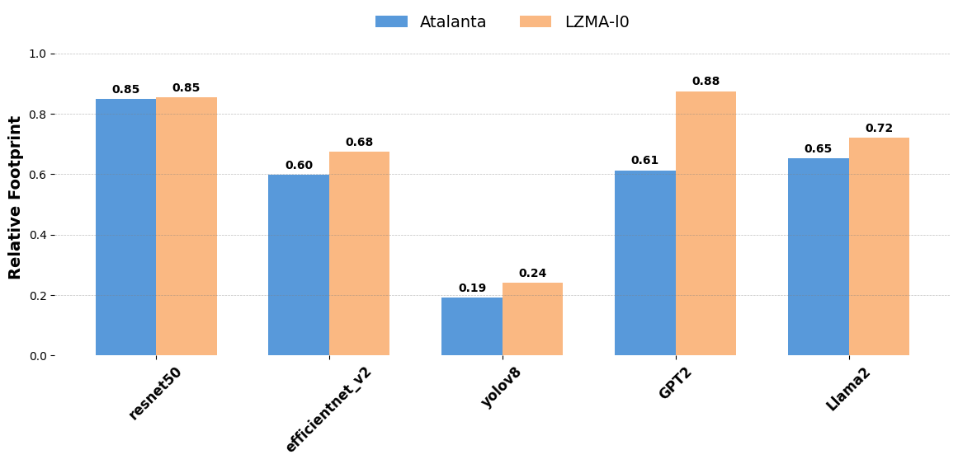


Compression Performance: Weights
$$−37\%$$
Notes:
When compared to one of LZMA configurations,
Atalanta matched its compression performance for Resnet50
and outperformed it for all other models with
a maximum of 37% more reduction in footprint

Slide 25
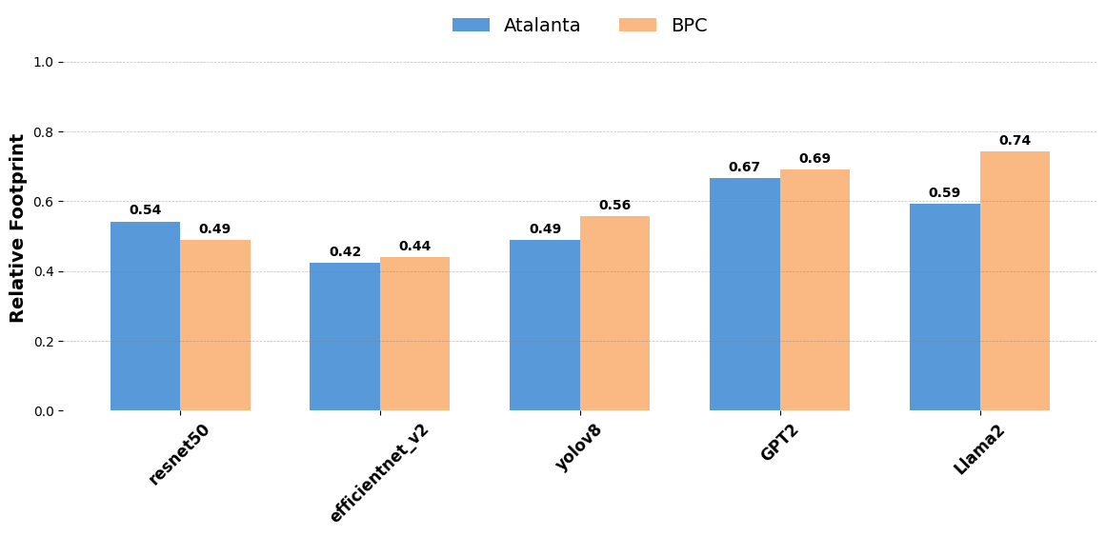


Compression Performance: Activations
$$−15\%$$
$$+5\%$$
Notes:
For Activations,
BPC outperfermod Atalanta in Resnet50 by 5% difference
While Atalanta outperforms BPC in all other models including transformer models with a maximum of 15% extra reduction

Slide 26
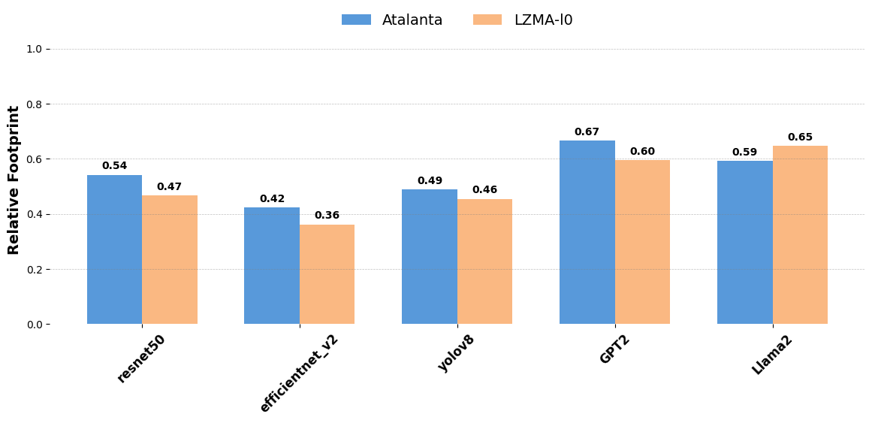


Compression Performance: Activations
$$−6\%$$
$$+7\%$$
Notes:
compared to the same LZMA configuration but for Activations,
LZMA slightly outperformed Atalanta for vision models and GPT with a maximum difference of 7% in footprint reduction
While Atalanta outperformed it for llama2 by 6% difference

Slide 27
Energy Efficiency and Speedup
Accelerator
Tensor Cores
Speedup: 1.44x
Energy Efficiency: 1.37x
Notes:
In Hardware, Atalanta can be be seamlessly integrated with DL accelerators at low cost.
When integrated with a Tensorcore-based accelerator, Atalanta improved performance and energy efficiency by 1.44 and 1.37 times, respectively.

Slide 28
Training for Fixed-Point Inference
Forward Pass
D
C
D
C
D
C
Off-chip memory
C
D
C
D
C
D
Backward Pass
Notes:
Atalanta can also reduce data footprints while training for fixed point data. In training, activations are temporarily stored in off-chip memory during the forward pass and then retrieved for gradient calculations during the backward pass. Also for large models weights are also stored in off-chip memory and accessed as needed.
Atalanta compresses these weights and activations before sending them to memory and decompresses them when they are retrieved for processing.

Slide 29
Compression Performance During Training
@Epoch 3:
Footprint = 0.56
@Epoch 35:
Footprint = 0.70
@Epoch 36:
Footprint = 0.40
@Epoch 65:
Footprint = 0.41
@Epoch 66:
Footprint = 0.39
Training Epochs
Table1
Table2
Table3
@ Epoch 0:
Generate
Table 1
@ Epoch 35:
Regenerate
Table 2
@ Epoch 65:
Regenerate
Table 3
Notes:
The nature of training data is different, as both weights and activations distribution continue to change across training epochs. -- For our experiments with Resnet18, Atalanta generates probability tables at distant epochs starting at epoch
0,
35
and 65. every table is used until the other one is generated and we measure the relative footprint at different times.
The measurement at epoch 3 shows a relative footprint of 56%
And at epoch35 shows that even when using a table generated far in the past at epoch 0, Atalanta still reduces footprint to 70%.
the reduction in boosted further in E36 after generating the new table to 40%.
And continues to be around 40% for the rest of training.

Slide 30


  Conclusions
Atalanta
Off-Chip
Memory
Accelerator
$$A →0.48 A$$
$$W →0.6 W$$
Fixed-point Data
Lossless
Transparent
Low-cost
Notes:
To conclude, Atalanta is a lossless hardware-software co-designed compression engine that lowers communication footprint for both fixed-point inference and training -- it has low hardware costs and high energy efficiency -- it's also programmer transparent and can be seamlessly integrated with any AI accelerator.

Slide 31
  Thank you!

