Slide 1







Spira
Exploiting Voxel Data Structural Properties for Efficient Sparse Convolution in Point Cloud Networks
Dionysios Adamopoulos,
Anastasia Poulopoulou, Georgios Goumas, Christina Giannoula
MLSys 2026
Bellevue, USA, May 22nd, 2026

Slide 2

Executive Summary
Motivation: Sparse Convolution (SpC) is a key operator in point cloud networks widely used in
autonomous driving, robotics, AR/VR…
Problem: SpC execution on GPUs has a mapping step and a feature computation step; prior works incur significant pre- and post-processing overheads in the mapping step of SpC
Opportunities: We identify that SpC operates on voxel data that have inherent structural properties, which existing works do not exploit them
Spira: The first SpC engine for point cloud networks on GPUs that
intelligently leverages structural properties of voxel data
effectively mitigates pre- and post-processing costs in the SpC mapping step
Key Results: Spira improves inference performance over existing state-of-the-art frameworks by 1.68× averaged across six GPU architectures
Spira is open-source:
GitHub

Slide 3
Outline
Background
Prior Works
Voxel Data Properties
Spira Design
Evaluation

Slide 4
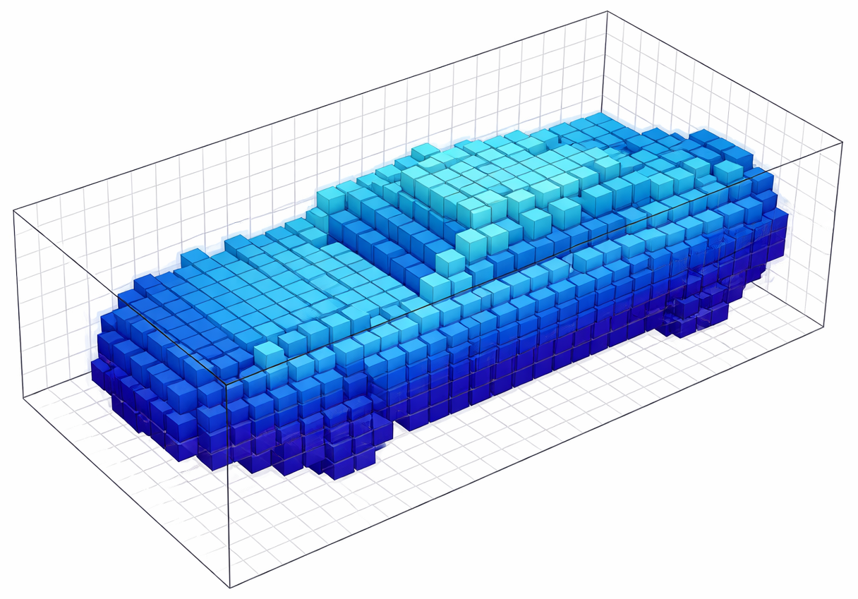

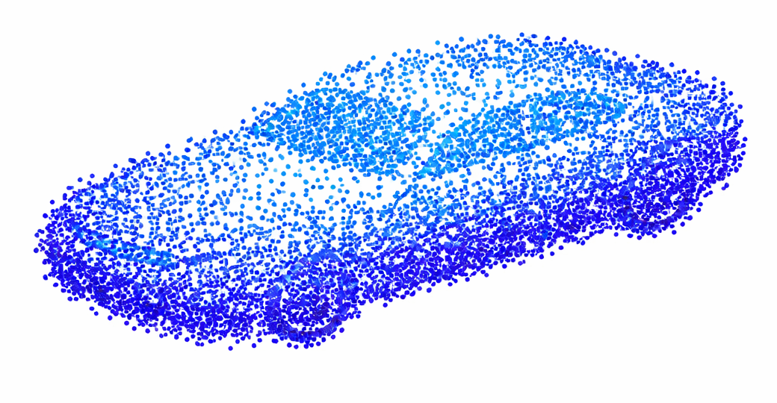
LiDAR Scanners Collect 3D Point Clouds
Transformed into 3D discrete cubes (voxels)
that are grid-aligned
LiDAR Scanners
capture
3D Point Clouds
Voxelized Point Cloud
(abbr. voxel data)

Slide 5
Point Cloud Networks Rely on Sparse Convolution (SpC)
Point cloud networks efficiently process voxel data using Sparse Convolution
Sparse
Convolution
Batch
Normalization
ReLU
Activation
Sparse
Convolution
Batch
Normalization
ReLU
Activation
…
non-zero voxel at (x, y, z) location
zero voxel at (x, y, z) location
Voxel data
highly sparse (usually less than 1%)

Slide 6
SpC Preserves the Sparsity in Output
P₀
Q₀
Q₁
Q₀
Q₁
P₁
W₀
W₁
W₂
Q₂
Q₂
P₂
W₃
W₄
W₅
Q₃
Q₃
P₃
P₄
W₆
W₇
W₈
Q₄
Q₄
P₅
P₆
W: Weights
Q₅
Q₆
P: Input Non-Zero Coord.
Q: Output Non-Zero Coord.

Slide 7
The 2 Steps of SpC
The Mapping Step
The Feature Computation Step
=
+
guides
1. mapping
P₃
offs(W₀)
Q₄
2 .feature
computation
x
=
FP: Features
W₀
FQ: Features
P₀
Q₀
Q₁
Q₀
Q₁
P₁
W₀
W₁
W₂
Q₂
Q₂
P₂
W₃
W₄
W₅
Q₃
Q₃
P₃
W₆
W₇
W₈
F: Feature
P₄
Q₄
Q₄
P₅
P₆
W: Weights
Q₅
Q₆
P: Input Non-Zero Coord.
Q: Output Non-Zero Coord.

Slide 8
The 2 Steps of SpC
Search Phase
(generated) Queries
Mappings
+
=
found!
+
=
1. mapping
P₃
Q₄
P?
offs(W₀)
offs(W₀)
Q₄
Q₄
offs(W₀)
P₃
2 .feature
computation
x
=
FP: Features
W₀
FQ: Features

Slide 9
The Search Phase of the Mapping Step
Creates the mappings between the input, weights and output non-zero voxels
Search Phase
(generated) Queries
Mappings
+
=
found!
offs(W₀)
Q₄
P?
offs(W₀)
Q₄
P₃
valid entry
(mapping found)
offs(W₀) offs(W₁) offs(W₂) …
searches
Q₀
Q₁
P₀
P₁
P₂
P₃
P₄
Q₂
invalid entry
(no mapping)
P: Input Non-Zero Coord.
Q₃
Q₄
…
Kernel Map

Slide 10
The 2 Steps of SpC
1. mapping
P₃
offs(W₀)
Q₄
Search Phase
(generated) Queries
Mappings
+
=
found!
offs(W₀)
Q₄
P?
offs(W₀)
Q₄
P₃
2 .feature
computation
x
FP: Features
W₀
FQ: Features
OR
(A) Output-Stationary execution dataflow
(B) Weight-Stationary
execution dataflow

Slide 11
Two Dataflows for the Feature Computation Step
Two different execution dataflows about how to process the kernel map and produce the output features
offs(W₀) offs(W₁) offs(W₂) …
offs(W₀) offs(W₁) offs(W₂) …
consecutive elems in memory
Thread Block 1
consecutive elems in memory
Thread Block 2
Thread Block 1
Thread Block 2
Kernel Map
(row-major)
Kernel Map
(column-major + filtered)
performs better when having
small #invalid entries (dense-friendly)
performs better when having
large #invalid entries (sparse-friendly)
(A) Output-Stationary execution dataflow
(B) Weight-Stationary
execution dataflow
invalid entry
valid entry
Either dataflow performs best depending on data and layer characteristics

Slide 12
Outline
Background
Prior Works
Voxel Data Properties
Spira Design
Evaluation

Slide 13
Prior Works Have a Pre-Process Phase in the Mapping Step
Prior works introduce pre-processing the input coordinates before the search phase
Pre-process Phase
Search Phase
Sorted Input Coord. Array
Sorted Input Coord. Array
Queries
Mappings
P₀
P₁
P₂
P₃
P₄
…
+
=
offs(W₀)
Q₄
P?
offs(W₀)
Q₄
P₃
pre-process
offs(W₀) offs(W₁) offs(W₂) …
searches
Q₀
P₂
…
P₂
…
Q₁
P₀
P₀
P₄
P₄
Q₂
P₁
P₃
P₁
P₃
Q₃
P: Input Non-Zero Coord.
P: Input Non-Zero Coord.
Q₄
…
(pre-processed)
Kernel Map

Slide 14
Prior Works Have Large Pre-Processing Costs
1. mapping
P₃
offs(W₀)
Q₄
Pre-process Phase
Search Phase
(generated) Queries
Mappings
+
=
found!
offs(W₀)
Q₄
P?
offs(W₀)
Q₄
P₃
2 .feature
computation
x
  e.g., Minuet [Yang et al., EuroSys’24] → pre-processing time is almost equal to search time
FP: Features
W₀
FQ: Features
OR
(A) Output-Stationary execution dataflow
(B) Weight-Stationary
execution dataflow

Slide 15
Prior Works Have a Post-Process Phase in the Mapping Step
Prior works need to perform post-processing on the kernel map to support both output- and weight-stationary dataflows
Post-process Phase
offs(W₀) offs(W₁) offs(W₂) …
offs(W₀) offs(W₁) offs(W₂) …
offs(W₀) offs(W₁) offs(W₂) …
transpose
filter
Kernel Map
(column major + filtered)
Kernel Map
(row major)
Kernel Map
(column major)

Slide 16
Prior Works Have Large Post-Processing Costs
1. mapping
P₃
offs(W₀)
Q₄
Pre-process Phase
Search Phase
Post-process Phase
(generated) Queries
Mappings
+
=
found!
offs(W₀)
Q₄
P?
offs(W₀)
Q₄
P₃
2 .feature
computation
x
FP: Features
W₀
FQ: Features
  Minuet [Yang et al., EuroSys’24] → only weight-stationary dataflow
  TorchSparse++ [Tang et al., MICRO’23] → post-processing costs
  up to ~40% of a layer in the weight-stationary dataflow
OR
(A) Output-Stationary execution dataflow
(B) Weight-Stationary
execution dataflow

Slide 17
Outline
Background
Prior Works
Voxel Data Properties
Spira Design
Evaluation

Slide 18
Identified Voxel Structural Properties
We identify three properties regarding real-world voxel data:
Integer Property
Bounded Property
Neighboring Property
Voxel data

Slide 19
Integer Property
Voxel coordinates are integer-valued: a triplet of values represents a discrete location in a 3D grid
Non-zero coordinate at (x, y, z) location
(42,7,12)
integer values

Slide 20
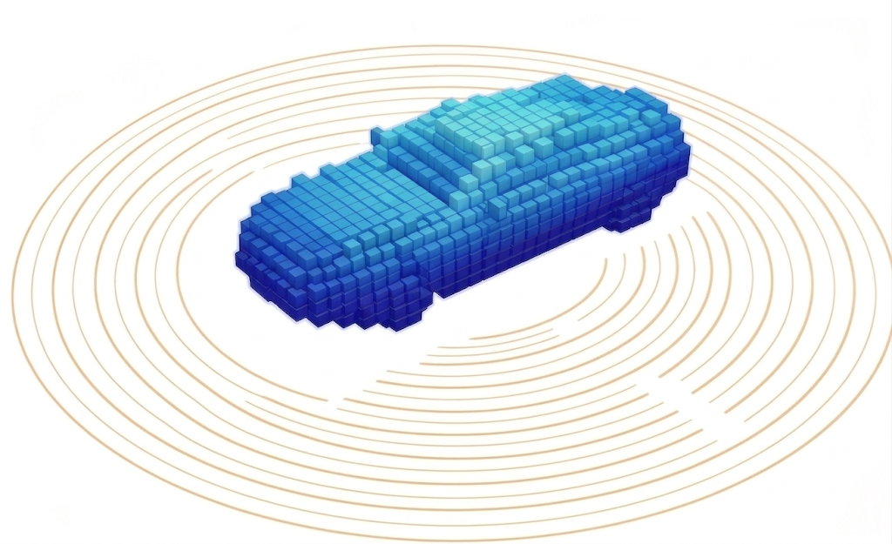
Bounded Property
Voxel coordinates are spatially constrained due to technological sensor limits
Non-zero coordinate at (x, y, z) location
(0,0,0) < (42,7,12) < (800,800,100)
bounded range
limited capture range of
LiDAR sensors

Slide 21

Neighboring Property
Neighboring voxel coordinates of the same object surface are likely to exist in small offset displacements
large offset: no same object surface
small offset: same object surface
x
y
Existing SpC engines [e.g., TorchSparse++’23, Minuet’24]
do not leverage structural properties of voxel data
z

Slide 22
Outline
Background
Prior Works
Voxel Data Properties
Spira Design
Evaluation

Slide 23
Designing Spira
The first voxel-property-aware SpC engine
Spira incorporates 4 key components:
One-Shot Z-Delta Search Mapping
Packed-Native Mapping Step
Adaptive Hybrid Dataflow Execution
Network-Wide Mapping

Slide 24
One-Shot Search in the Mapping Step
Spira eliminates pre-processing by directly searching on the sorted input coordinates as given
Existing Works
Spira
Pre-process Phase
Search Phase
P₀
P₁
P₂
P₃
P₄
…
Sorted Input Coord. Array
Queries
Mappings
+
=
offs(W₀)
Q₄
P?
offs(W₀)
Q₄
P₃
Pre-process
offs(W₀) offs(W₁) offs(W₂) …
searches
Q₀
P₂
…
P₂
…
Q₁
P₀
P₀
P₄
P₄
Q₂
P₁
P₃
P₁
P₃
Q₃
P: Input Non-Zero Coord.
P: Input Non-Zero Coord.
Q₄
…
(pre-processed)
Kernel Map

Slide 25
Key Observation on Consecutive Weight Offsets
Queries
+
=
offs(W₀)
Q₄
P?
searches
P₀
P₁
P₂
P₃
P₄
…
Sorted Input Coord. Array

Slide 26
Key Observation on Consecutive Weight Offsets
Integer Property
Consecutive Weight Offsets
Output Coordinate
Generated Consecutive Queries
offs(W₀) = (0,0,-1)
(50,4,5) = P?
+
Q₄
(50,4,6)
identical x, y values +
consecutive z values
K size
offs(W₁) = (0,0,0)
K size
(50,4,6) = P?
offs(W₂) = (0,0,1)
(50,4,7) = P?
K size
W₀
W₁
W₂
offs(W₀), offs(W₁), offs(W₂):
identical x, y values +
consecutive z values
e.g., (0,0,-1) (0,0,0) (0,0,1)
Consecutive weight offsets in z-axis produce consecutive queries
W₃
W₄
W₅
W₆
W₇
W₈
W: Weights

Slide 27
One-Shot Z-Delta Search Mapping
Integer Property
Consecutive Weight Offsets
Output Coordinate
Generated Consecutive Queries
offs(W₀) = (0,0,-1)
(50,4,5) = P₃
(50,4,5) = P?
+
Q₄
(50,4,6)
offs(W₁) = (0,0,0)
(50,4,6) = P₄
K size
K size
(50,4,6) = P?
offs(W₂) = (0,0,1)
(50,4,7) = P?
(50,4,7) = P₅
Binary
search
Linear
search
P₀
P₁
P₂
P₃
P₄
P₅
P₆
P₀
P₁
P₂
P₃
P₄
…
(50,2,3)
(50,3,9)
(50,4,1)
(50,4,5)
(50,4,6)
(50,4,7)
(50,5,3)
(50,4,5)
(50,4,6)
(50,4,7)
Sorted Input Coord. Array
K size
. . .
→ binary search
K consecutive queries can only map to
up to K consecutive elements in the sorted input coordinates
. . .
→ linear search

Slide 28
Designing Spira
The first voxel-property-aware SpC engine
Spira incorporates the following 4 key components:
One-Shot Z-Delta Search Mapping
No pre-processing costs
High data locality
~K× less binary searches
Packed-Native Mapping Step
Adaptive Hybrid Dataflow Execution
Network-Wide Mapping

Slide 29
Packed-Native Mapping Step
Integer Property
Bounded Property
Key Idea: pack all coordinates into a single integer number (32-bit or 64-bit)
Pack only once at the network start; perform mapping steps as packed-native
Prior Works
three coordinates
X
Y
Z
32 bits
32 bits
32 bits
Spira
one packed coordinates
memory footprint and computation cost gain
X|Y|Z
32 bits
Voxel Coordinates require less bits in the x-, y-, z- axis

Slide 30
Designing Spira
The first voxel-property-aware SpC engine
Spira incorporates the following 4 key ideas:
One-Shot Z-Delta Search Mapping
No pre-processing costs
High data locality
~K× less binary searches
Packed-Native Mapping Step
~3× less #comparisons
~3× less #memory accesses
Adaptive Hybrid Dataflow Execution
Network-Wide Mapping

Slide 31


Adaptive Hybrid Dataflow Execution
Neighboring Property
Kernel Map
#valid entries $↑$
#valid entries $↓$
offs(W₀) offs(W₂) offs(W₅) offs(W₁) offs(W₃) offs(W₄) offs(W₆) …
Columns associated to smaller offset displacements have larger #valid entries in the Kernel Map

Slide 32



Adaptive Hybrid Dataflow Execution
Neighboring Property
Different weight offsets in kernel map can be processed with either output- or weight-stationary dataflow execution
Kernel Map
output-stationary exec.
#valid entries $↑$
weight-stationary exec.
#valid entries $↓$
offs(W₀) offs(W₂) offs(W₅) offs(W₁) offs(W₃) offs(W₄) offs(W₆) …
tunable configuration

Slide 33
Dataflow-aware Kernel Map Post-Processing
Three possible dataflow scenarios:

Slide 34
Dataflow-aware Kernel Map Post-Processing
Three possible dataflow scenarios:
3. Hybrid-Dual: directly materialized as column-major
Kernel Map
output-stationary exec.
weight-stationary exec.
offs(W₀) offs(W₂) offs(W₅) offs(W₁) offs(W₃) offs(W₄) offs(W₆) …

Slide 35
Dataflow-aware Kernel Map Post-Processing
Three possible dataflow scenarios:
3. Hybrid-Dual: directly materialized as column-major
Kernel Map
output-stationary exec.
weight-stationary exec.
offs(W₀) offs(W₂) offs(W₅) offs(W₁) offs(W₃) offs(W₄) offs(W₆) …
filter only the part processed by weight-stat
transpose only the part processed by output-stat

Slide 36
Dataflow-aware Kernel Map Post-Processing
Three possible dataflow scenarios:
1. Pure Output-Stat: directly materialized as row-major → no post-processing
3. Hybrid-Dual: directly materialized as column-major
Kernel Map
output-stationary exec.
offs(W₀) offs(W₁) offs(W₂) offs(W₃) offs(W₄) offs(W₅) offs(W₆) …

Slide 37
Dataflow-aware Kernel Map Post-Processing
Three possible dataflow scenarios:
1. Pure Output-Stat: directly materialized as row-major → no post-processing
2. Pure Weight-Stat: directly materialized as column-major →
3. Hybrid-Dual: directly materialized as column-major
weight-stationary exec.
Kernel Map
offs(W₀) offs(W₁) offs(W₂) offs(W₃) offs(W₄) offs(W₅) offs(W₆) …

Slide 38
Dataflow-aware Kernel Map Post-Processing
Three possible dataflow scenarios:
1. Pure Output-Stat: directly materialized as row-major → no post-processing
2. Pure Weight-Stat: directly materialized as column-major → only filtering
3. Hybrid-Dual: directly materialized as column-major
weight-stationary exec.
Kernel Map
offs(W₀) offs(W₁) offs(W₂) offs(W₃) offs(W₄) offs(W₅) offs(W₆) …
filter

Slide 39
Designing Spira
The first voxel-property-aware SpC engine
Spira incorporates the following 4 key ideas:
One-Shot Z-Delta Search Mapping
No pre-processing costs
High data locality
~K× less binary searches
Packed-Native Mapping Step
~3× less #comparisons
~3× less #memory accesses
Minimal post-processing costs in all dataflows
Adapting execution schema based on data and layer characteristics
Adaptive Hybrid Dataflow Execution
Network-Wide Mapping

Slide 40
Network-Wide Mapping
Key Observation: Mapping steps have no true dependencies neither with feature computation steps nor between them
Spira executes all mapping steps concurrently at network start and significantly improves GPU SM utilization
SpC layer 1
SpC layer 2
Prior Works
Mapping
Feature
Computation
Batch
Normalization
ReLU
Activation
Mapping
Feature
Computation
Batch
Normalization
ReLU
Activation
…
sequential execution of mapping steps
Spira
Mapping
performance gain
Feature
Computation
Batch
Normalization
ReLU
Activation
Feature
Computation
Batch
Normalization
ReLU
Activation
…
Mapping
concurrent execution of mapping steps

Slide 41
Designing Spira
The first voxel-property-aware SpC engine
Spira incorporates the following 4 key ideas:
One-Shot Z-Delta Search Mapping
No pre-processing costs
High data locality
~K× less binary searches
Packed-Native Mapping Step
~3× less #comparisons
~3× less #memory accesses
Minimal post-processing costs in all dataflows
Adapting execution schema based on data and layer characteristics
Adaptive Hybrid Dataflow Execution
Network-Wide Mapping
Higher execution parallelism
Higher GPU utilization

Slide 42
Outline
Background
Prior Works
Voxel Data Properties
Spira Design
Evaluation

Slide 43
Evaluation Methodology
3x Point Cloud Networks: ResNet, Large ResNet, UNet
3x Datasets: Waymo, SemanticKITTI, ScanNet
6x GPUs:
  A100, H100: datacenter
  Quadro RTX 5000: workstation
  GTX 1060, RTX 3090: consumer
  Jetson Orin AGX: edge GPU platform
Comparison points:
  TorchSparse++ [MICRO’23] - supports both output- and weight-stationary dataflow
  Minuet [EuroSys’24] – supports only weight-stationary dataflow

Slide 44
Inference Performance across Multiple GPUs
Averaged inference results across 3 networks and 3 datasets
datacenter
workstation
consumer
  edge GPU platform
Spira significantly outperforms prior SpC engines
by 1.68× averaged across six GPUs

Slide 45
Breakdown of Spira’s Key Ideas
Spira (Z-Delta Search) + Packing + Hybrid Dual Dataflow
Spira (Z-Delta Search) + Packing + Hybrid Dual Dataflow + Network-wide Mapping
Speedup

Slide 46
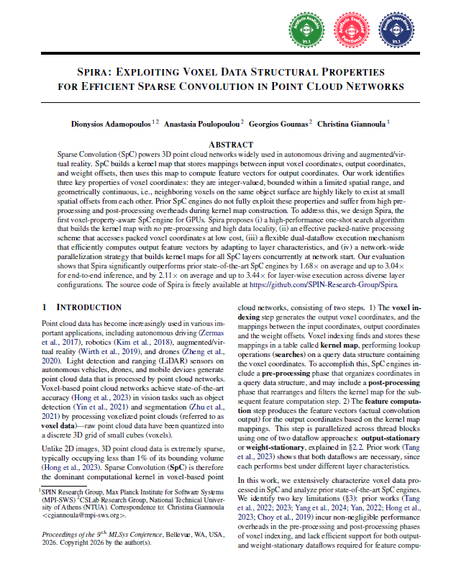
More in the Paper
Detailed inference analysis for various datasets and networks
Layer-wise analysis
Hybrid dataflow sensitivity analysis
Mapping step analysis
Effect of network-wide mapping
Input density ablation study
Scalability study
Memory footprint study
https://arxiv.org/abs/2511.20834

Slide 47
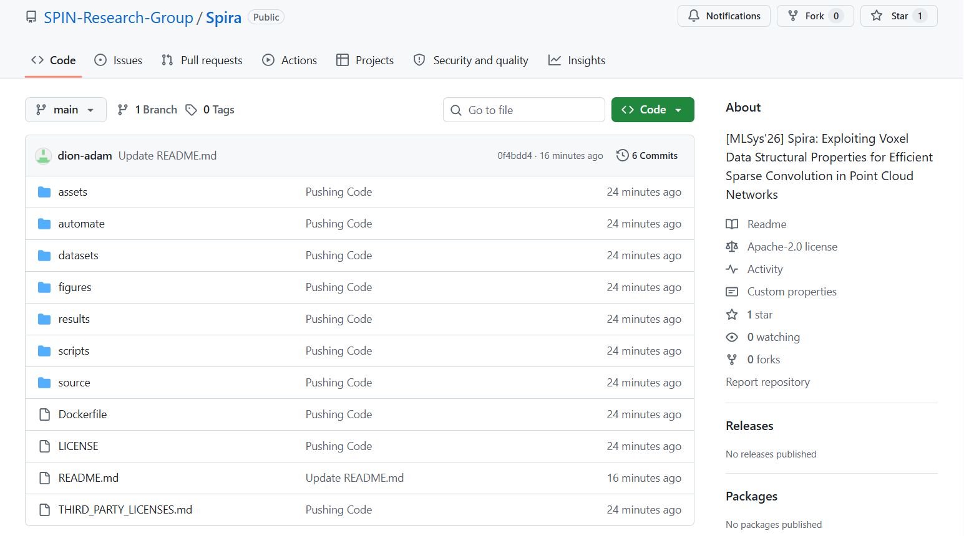
Spira is Open Source
Spira
https://github.com/SPIN-Research-Group/Spira

Slide 48

Conclusion
Spira is the first SpC engine that leverages structural properties of voxel data and significantly improves performance of point cloud networks on GPUs
Key Ideas & Benefits:
completely eliminates pre-processing costs in the mapping step
enables high data locality and low computational cost in the search phase of the mapping step via an intelligent search algorithm
proposes a packing format that reduces memory accesses and computation cost on voxel coordinate processing
supports a tunable adaptive dataflow schema with low post-processing costs
executes all mapping steps concurrently to improve GPU utilization
GitHub
Key Results: improves inference performance by on average 1.68× over existing state-of-the-art SpC engines across six GPU architectures, spanning from datacenter to edge GPU devices
Paper

Slide 49
Spira
Exploiting Voxel Data Structural Properties for Efficient Sparse Convolution in Point Cloud Networks
Dionysios Adamopoulos,
Anastasia Poulopoulou, Georgios Goumas, Christina Giannoula
MLSys 2026
Bellevue, USA, May 22nd, 2026

